Slide 1

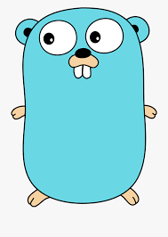
What is Go ?
Mukunthan Ragavan

Slide 2
Go is a statically typed, compiled programming language designed at Google by Robert Griesemer, Rob Pike, and Ken Thompson. Go is syntactically similar to C, but with memory safety, garbage collection, structural typing, and CSP-style concurrency. (Wiki)
Ex: Devops tools ( Docker, Kubernetes)

Slide 3
Why Go ?
Mukunthan Ragavan

Slide 4
Concurrency
Runs directly in machine, not on Virtual Machine.
No Classes, no inheritance, no annotation, no generics, no exceptions, no private scope.
Google support.
Easiness like Python and Performance, safety like Java.
Open source.
Only 25 Keywords.
Serverside language.
Garbage collection.
First class function (functions can be returned/passed)
Only 3 scopes (Local, Package only, Package public scope).
Built in support for unicode characters.
  Ex fmt.Println("Hello, 世界")

Slide 5
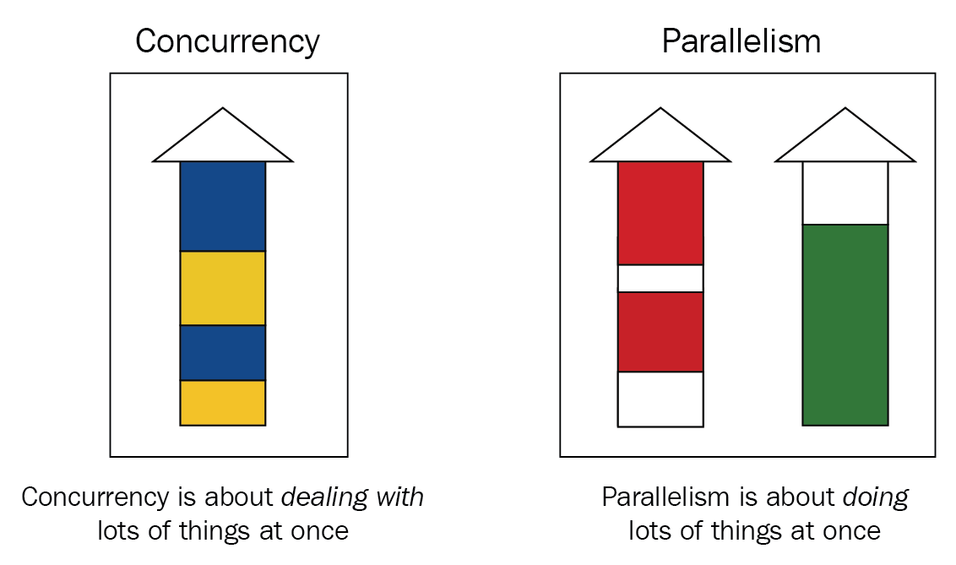

Slide 6
Concurrency is the act of running and managing multiple tasks at the same time. On the other hand, parallelism is the act of running various tasks simultaneously.
Parallelism is obtained by using multiple CPUs, like a multi-processor system and operating different processes on these processing units or CPUs. In contrast, concurrency is achieved by interleaving operation of processes on the CPU and particularly context switching.

Slide 7
Install Go
Mukunthan Ragavan

Slide 8
walkthrough of Hello Go !
Mukunthan Ragavan

Slide 9
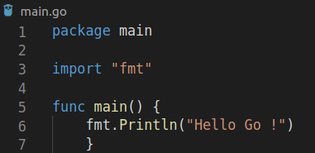
walkthrough of Hello Go !

Slide 10
walkthrough of Hello Go !
main package with main func will be executed. File name as main.go is optional
if multiple files having package as main , only one file should have main func
import will get other packages , method are in scope will have prefix Upper case

Slide 11
walkthrough of Hello Go !
Scenarios:
run/build file name as test1.go with main package and main func
build test1.go , test2.go , test3.go has package as main and all has main func
run/build - package is not main
run/build - package as main without main func

Slide 12
Variables
Static typed
Mukunthan Ragavan

Slide 13
Data Types
Integer & Float
Mukunthan Ragavan

Slide 14
le
Integers
Float
String
Boolean
Arrays
Slices
Maps

Slide 15
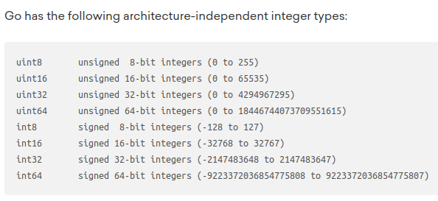


Slide 16
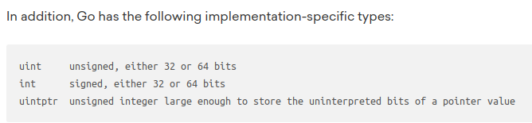
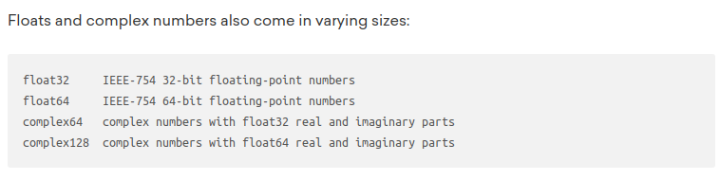

Slide 17
Understanding Character, ASCII,
Unicode & RUNE
Mukunthan Ragavan

Slide 18
Understanding Character & ASCII
A character is any symbol that represents information.
In computing terms, everything is represented in a sequence of 1s and 0s and characters as well.
The ASCII maps every English character along with numbers and symbols to a number ranging from 32 - 127.
Codes below 32 were called unprintable and were used as control characters,
for example, 7 which made your computer beep and 10 for LF (line feed).
That means every character can be represented by a single byte (8 bits).

Slide 19
Understanding Unicode & UTF-8 , UTF-16, UTF-32, UTF-64
The Unicode Standard provides a unique number for every character, no matter what platform, device, application or language.
UTF-8, the dominant encoding on the World Wide Web (used in over 95% of websites as of 2020, and up to 100% for some languages) uses one byte for the first 128 code points, and up to 4 bytes for other characters.
The first 128 Unicode code points represent the ASCII characters, which means that any ASCII text is also a UTF-8 text.
In other words, ASCII and Unicode before 127, are completely similar to each other.
Reference: https://www.unicode.org/charts/

Slide 20
Understanding RUNE
Finally, unicode characters can be represented using 1– 4 bytes,
Go has a builtin data structure specifically for storing Unicode Code Points called a rune .
While a byte is uint8, a rune is an int32 representing 4 bytes of memory, as 4 bytes is the max length for a Unicode Code Point.
The default type for character values is rune, which means, if we don’t declare a type explicitly when declaring a variable with a character value, then Go will infer the type as rune.

Slide 21
Arrays
Mukunthan Ragavan

Slide 22
Slices
Mukunthan Ragavan

Slide 23
Functions
Basics
Mukunthan Ragavan

Slide 24
Pointers
Mukunthan Ragavan

Slide 25
Packages
Mukunthan Ragavan

Slide 26
Imports
Mukunthan Ragavan

Slide 27
Constants
Mukunthan Ragavan

Slide 28
Operators
Mukunthan Ragavan

Slide 29
If Else
Mukunthan Ragavan

Slide 30
Switch
Mukunthan Ragavan

Slide 31
Select
Mukunthan Ragavan

Slide 32
Loops
Mukunthan Ragavan

Slide 33
Scope
Mukunthan Ragavan

Slide 34
Structs
Mukunthan Ragavan

Slide 35
Range
Mukunthan Ragavan

Slide 36
Maps
Mukunthan Ragavan

Slide 37
Casting
Mukunthan Ragavan

Slide 38
Interface
Mukunthan Ragavan

Slide 39
Defer
Mukunthan Ragavan

Slide 40
Concurrency
Mukunthan Ragavan

Slide 41
Goroutines
Mukunthan Ragavan

Slide 42
Channels
Mukunthan Ragavan

Slide 43
Error handling
Mukunthan Ragavan

Slide 44
File operations
Mukunthan Ragavan

Slide 45
Mutex
Mukunthan Ragavan

Slide 46
Unit
Testing
Mukunthan Ragavan

Slide 47
Test Driven Development
Mukunthan Ragavan

